Slide 1
1 Planed
Planed 1
Finish the project3.
Create my local git repository , and upload the code of project3.
The target is the same as last week.
4

Slide 2
1 Results
Results 1
There is some problem in repairing relocation rable.But I will solve it today ,14/8 2023.
The Uploading code doesn’t fallow the standard you gave me. But I will solve it today ,14/8 2023.
4

Slide 3
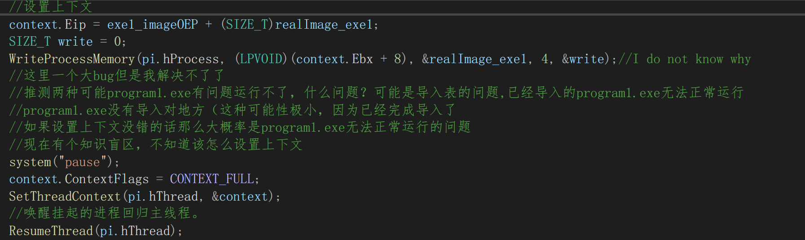
1 Challenges and Solutions
Challenges and solutions 1
Why need to set imagebase ? can I just set OEP?
4

Slide 4
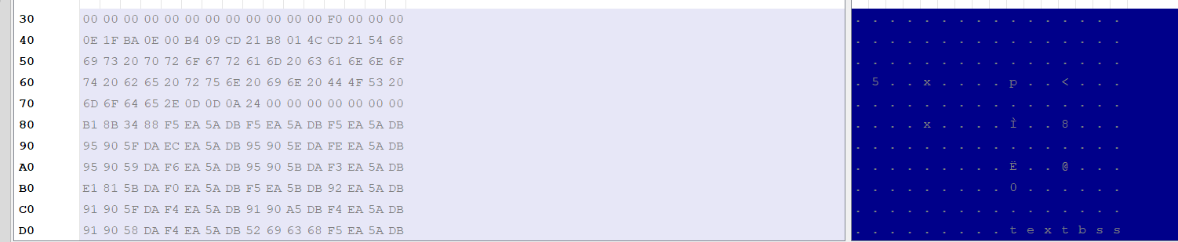
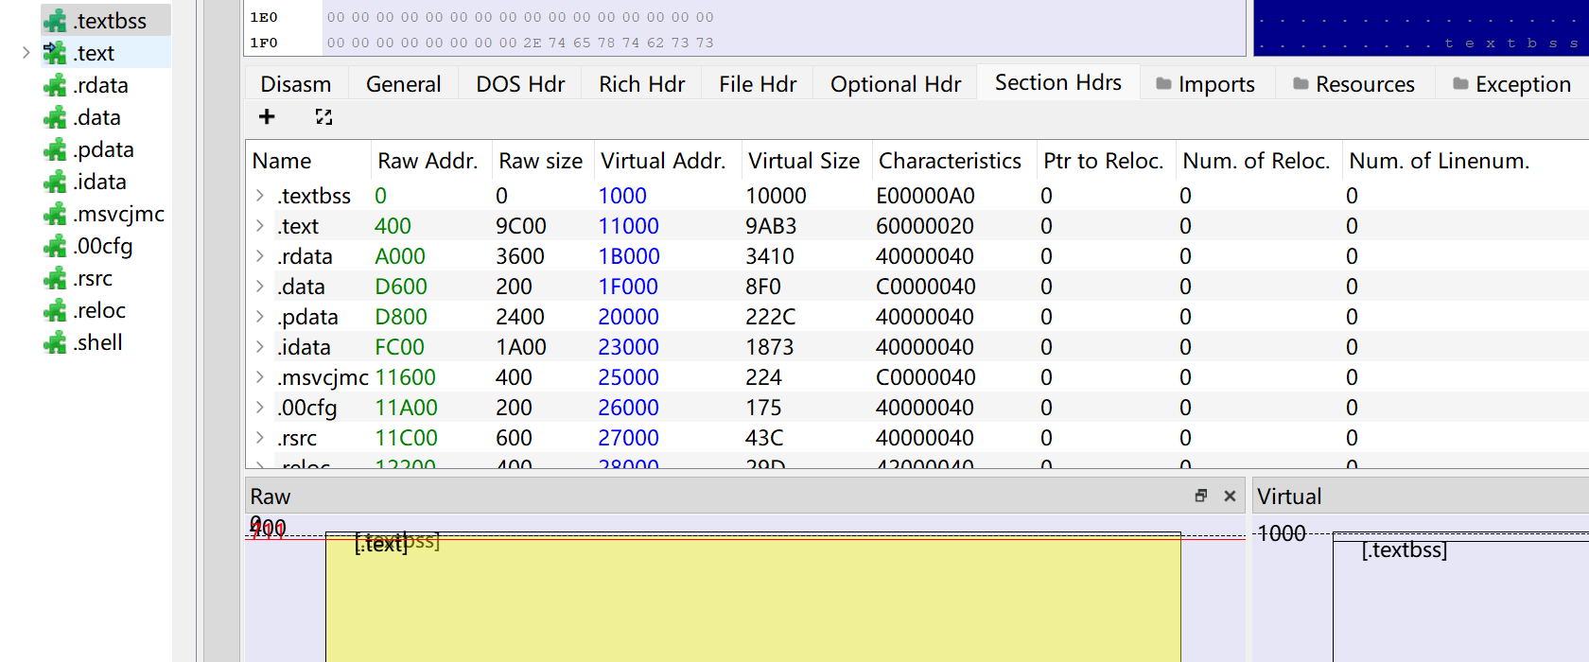
2 Challenges and Solutions
Challenges and solutions 2
amazing!I looked up it online , finding that “.textbss” is not the standard section in PE format . And I found this section stores the data about PE hears , but both raw address and raw size are zero , why? What is the function of this section?大概意思就是这个节点是用来干嘛的
4

Slide 5
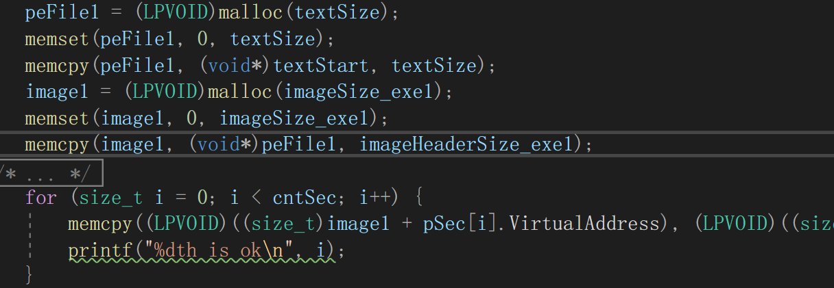
3 Challenges and Solutions
Challenges and solutions 3
I replace “DWORD’ with “size_t” then I solve this bug , but why? The size of pSec[i].VirtualAddress is DWORD.我怀疑是64位系统，这两个大小不同，问题已经解决了
4

Slide 6
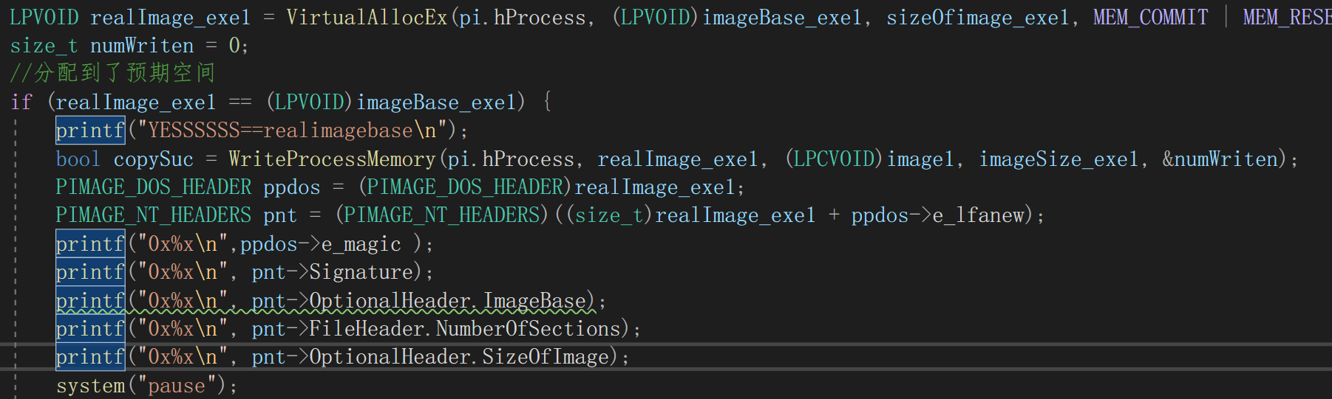
4 Challenges and Solutions
Challenges and solutions 4
I allocate memory for program1.exe and write it in this space in the suspended process , but this part can not be parsed .
I think that this memory is in the suspended process I do not have access to this memory?
问题解决，是我位置找错了
4

Slide 7
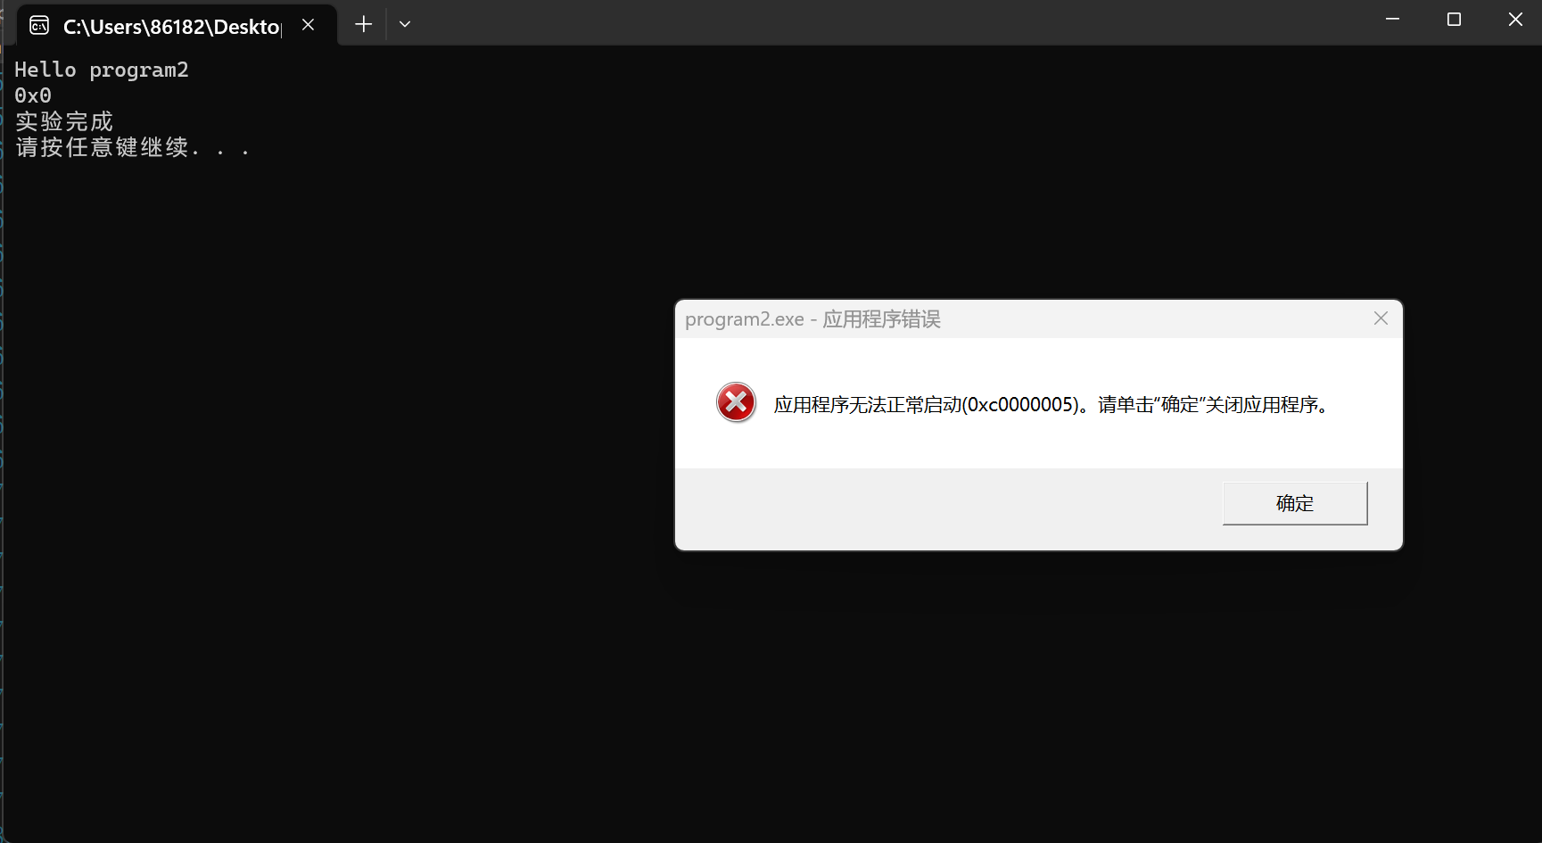
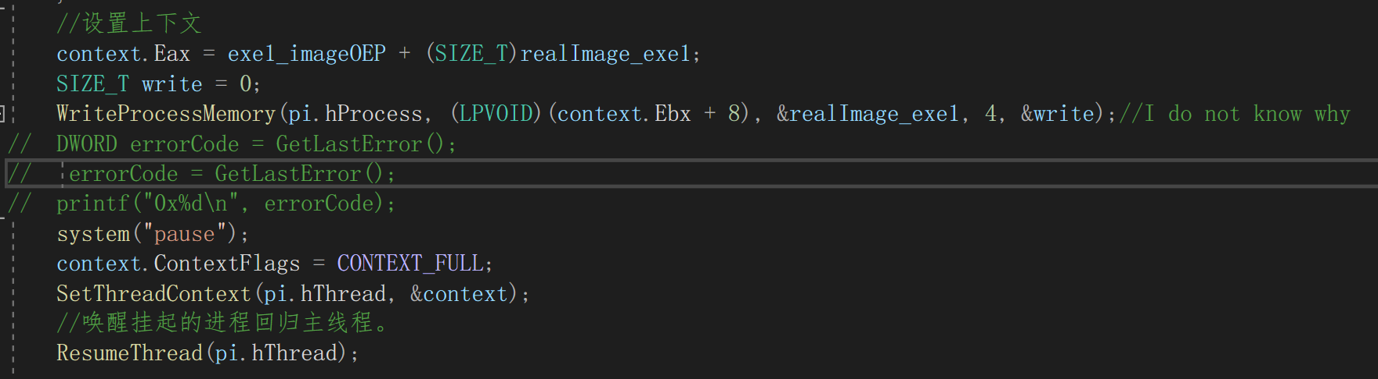
5 Challenges and Solutions
Challenges and solutions 5
This “0x0” is the value I get by using “GetLastError” which means there is no problem in my code. But after I use “ResumeThread()” the suspended process can not run!
The way to set context I learned from a blog , but I do not know why ? I look up online it says “the eax stores OEP of this process” .
The program2.exe still can not be executed.
解决了
4

Slide 8
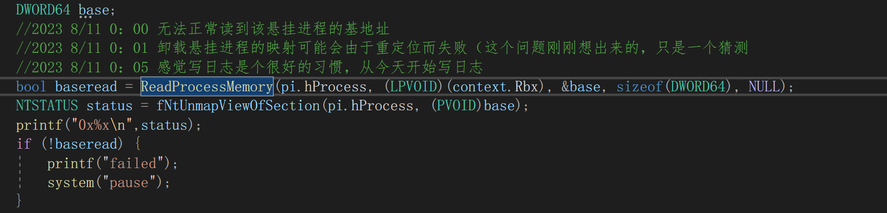
6 Challenges and Solutions
Challenges and solutions 6
The value returned by “ReadProcessMemory” is false . I want to get the image base of this suspended process by “ReadProcessMemory”,but failed.
Another question Whether every process occupies an independent space in memory . In every process memory , the starting address is 0x0.
已经理解了
memory
process1
0x0
memory
process2
0x1000
0x0
process1
process2
0x0
Or
0x1000
0x1000
4

Slide 9
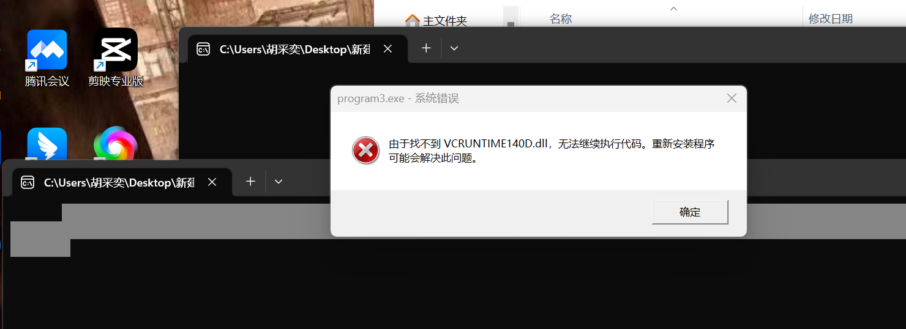
7 Challenges and Solutions
Challenges and solutions 7
The program can not run in my friends’ computer . I send her a zip package containing proram1.exe , program2.exe , program3.exe and no dll . The main reason is missing dll ? 我猜测是导入表找不到这个的dll的位置
4

Slide 10
1 Plan
plan 1
Remake a plan for the vedio , and start it.The vedio link : https://www.youtube.com/watch?v=1-j4sB6i-cE&amp;list=PLfauTfrIamWO0jaif_GrikGUuNiuHUXy9
4

